Slide 1
Exploring Detection Methods: Detecting Habitable Exoplanets
Maya Legersky, Brigid Dix, Dasha Crocker

Slide 2
Motivations
How do modern detection methods work? When are they most effective?
Can these methods be used to detect an Earth-like planet orbiting a Sun-like star?

Slide 3
Do you need longer text?
Methods
5 big methods of detection:
Transit (most planets found)
Radial Velocity
Direct imaging
Astrometry
Microlensing
Data pulled from NASA Exoplanet Data Explorer Archives
Sensitivity limit curves overlaid onto data

Slide 4
Methods (cont.)
To calculate detection signals of an Earth-like planet around a Sun-like star:
Assumed a system about 500 pc away, with parameters and orbit eccentricities the same as Earth and the sun
Signals derived from calculations in the Seager papers
Determined that microlensing had too many unknown parameters to create a consistent model

Slide 5
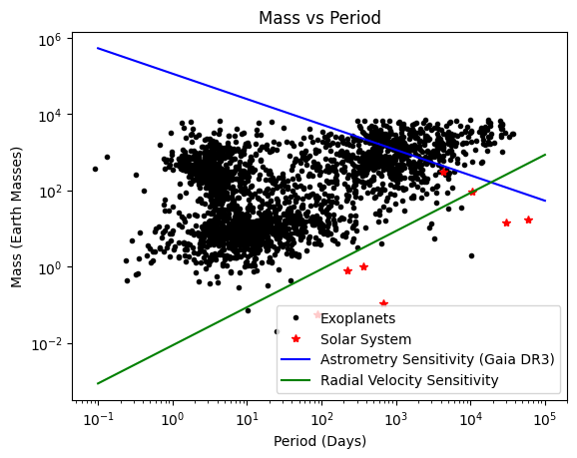
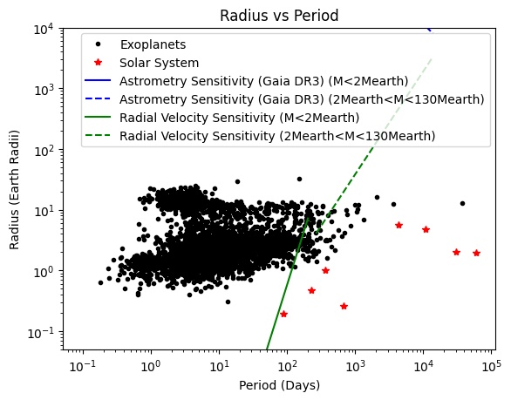
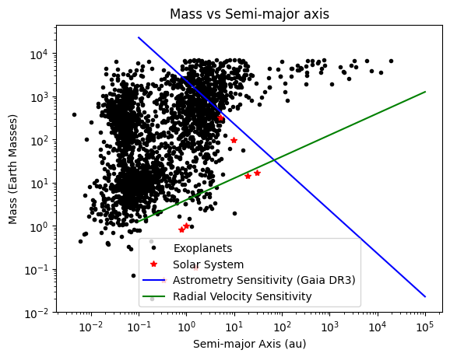
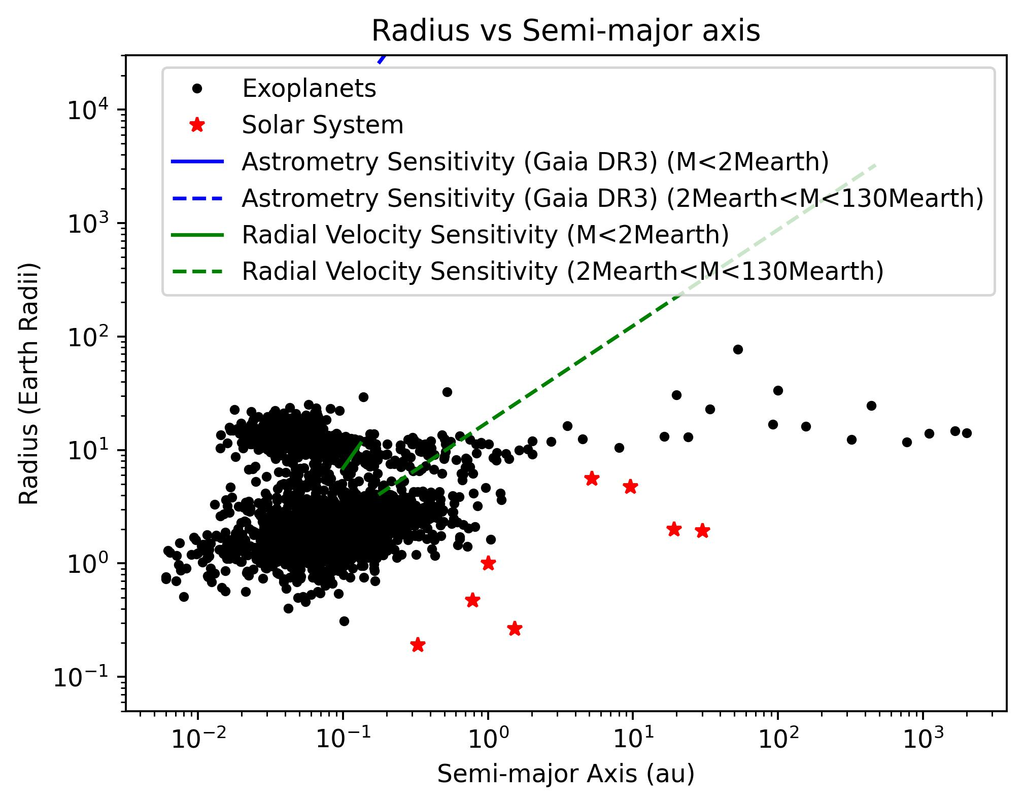
Theoretical detection limits
Notes:
We used the RV equation from class and eq1 from seager_astrometry. The radius plots have broken power laws bc the mass-radius relation changes

Slide 6
Results
For all 4 of the methods, detection signals would be too small to feasibly detect using these methods
Detection signals very different based off of the method
Distinctions between how the different methods measure
Conditions for a system like ours are difficult to detect

Slide 7
Conclusions
Under these conditions and in our model, not feasible to detect Earth-like planets in systems like our own
Model constraints
Further research:
How to experimentally measure sensitivity
Compare experimental and theoretical results
How have we detected Earth-like planets?

Slide 8
Thanks!
Do you have any questions?
Please keep this slide for attribution

Slide 9
Bibliography
Gaia Data Release 3 contents summary—Gaia—Cosmos, 2020, Gaia. Retrieved January 30, 2025, from https://www.cosmos.esa.int/web/gaia/dr3
Gaudi, Scott B. “Microlensing by Exoplanets.” Exoplanets, University of Arizona Press, 2010, pp. 79-110.
Lovis, Christophe & Fischer, Debra A. “Radial Velocity Techniques for Exoplanets.” Exoplanets, University of Arizona Press, 2010, pp. 27-53.
Mallonn, M., Poppenhaeger, K., Granzer, T., Weber, M., & Strassmeier, K. G. (2022). Detection capability of ground-based meter-sized telescopes for shallow exoplanet transits. Astronomy & Astrophysics, 657, A102. https://doi.org/10.1051/0004-6361/202140599
Quirrenbach, Andreas. “Astrometric Detection and Characterization of Exoplanets.” Exoplanets, University of Arizona Press, 2010, pp. 157–174.
Traub, Wesley A & Oppenheimer, Ben R. “Direct Imaging of Exoplanets.” Exoplanets, University of Arizona Press, 2010, pp. 111-156..
Winn, Joshua N. “Exoplanet Transits and Occultations.” Exoplanets, University of Arizona Press, 2010, pp. 55-77.

